Slide 1
Organelles and Illness
An Active-learning Exercise

Slide 2
Objectives
During the activity you will:
Assess the relationship between symptoms presented by patients and specific cellular functions (Evaluation).
Infer malfunctioning cellular organelles as being the cause of illness (Analysis).
Explain how the malfunctioning of a particular organelle can result in a given array of symptoms (Analysis).

Slide 3
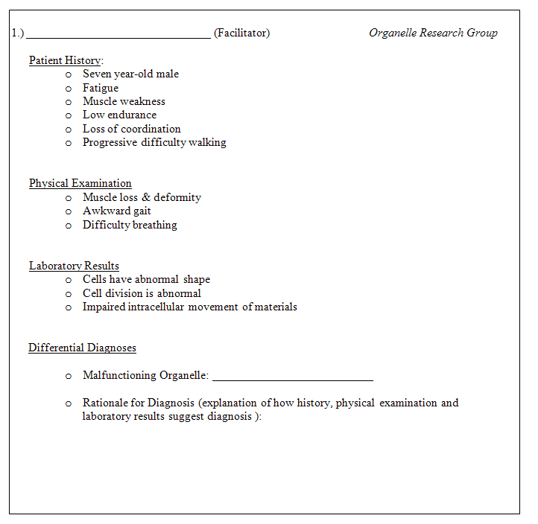
Organelles and Illness
Diagnose the malfunctioning organelle
Rationale

Slide 4
Activity Guide
Work in groups to diagnose each case.
A student must act as facilitator for each case.
Lead discussion; formalize group response.
Each student acts as discussant for other cases.
Provide insights & perspectives. Consider, compare & contrast inputs of others as you collaborate to form group response.
You may be called on to present your group’s answers to the class.

Slide 5
Patient History, Case 1
Seven year-old male
Fatigue
Muscle weakness
Low endurance
Loss of coordination
Progressive difficulty walking
Physical Examination
Muscle loss & deformity
Awkward gait
Difficulty breathing
Laboratory Results
Cells have abnormal shape
Cell division is abnormal
Impaired intracellular movement of materials

Slide 6
Patient History, Case Study 2
42 year-old male
No major health issue to date
Notable increase in weight over past month—gain of 17 pounds
Recent lethargy
Patient is on a new eating regimen—every meal is from a ‘fast-food’ restaurant
Physical Examination
Enlarged liver
Muscle weakness
Laboratory Results
Negative for hepatitis
Excessive glycogen granules in liver
High levels of fat in liver—abnormal fat metabolism
Low testosterone levels
Abnormal cell calcium balance

Slide 7
Physical Examination
Swelling of eyelids
Partial limb paralysis
Hyperkeratosis (increased pigmentation) of skin on palms & soles
White banding on fingernails
Muscle weakness
Laboratory Results
Low levels of ATP production
Unusually high levels of arsenic
Abnormal levels of cell death—not due to apoptosis (programmed cell death)—cell death appears to be due to lack of energy to maintain homeostasis due to low ATP levels.
Patient History, Case Study 3
55 year-old female
Excellent health to date
Recent onset of:
Fatigue
Headaches
Excessive salivation
Nausea
Vomiting
Diarrhea
Vertigo
Abdominal pain
Weight loss
Psychological stress
Recently won lottery
Marital stress

Slide 8
Patient History, Case Study 4 :
2-day old male
Low birth-weight (4pds. 5 ounces)
Difficulty suckling/swallowing
Seizures
Gastrointestinal bleeding
Physical Examination
Enlarged liver
Low muscle tone/inability to move
Glaucoma
Facial deformities
Impaired hearing
Jaundiced skin
Laboratory Results
High levels of hydrogen peroxide in cells
High levels of fats and amino acids in cells

